Slide 1
THE LIFE OF CHRIST
PART 6

Slide 2
Matthew 1:18 Now the birth of Jesus Christ was as follows: After His mother Mary was betrothed to Joseph, before they came together, she was found with child of the Holy Spirit. ¹⁹ Then Joseph her husband, being a just man, and not wanting to make her a public example, was minded to put her away secretly.

Slide 3
Matthew 1:20 But while he thought about these things, behold, an angel of the Lord appeared to him in a dream, saying, "Joseph, son of David, do not be afraid to take to you Mary your wife, for that which is conceived in her is of the Holy Spirit. ²¹ "And she will bring forth a Son, and you shall call His name JESUS, for He will save His people from their sins." ²² So all this was done that it might be fulfilled which was spoken by the Lord through the prophet, saying: ²³ "Behold, the virgin shall be with child, and bear a Son, and they shall call His name Immanuel," which is translated, "God with us."

Slide 4
Matthew 1:24 Then Joseph, being aroused from sleep, did as the angel of the Lord commanded him and took to him his wife, ²⁵ and did not know her till she had brought forth her firstborn Son. And he called His name JESUS.

Slide 5
We also learn from Matthew 13:55-56 that Jesus had 4 brothers and some sisters.

Slide 6
Luke 2:1 And it came to pass in those days that a decree went out from Caesar Augustus that all the world should be registered. ² This census first took place while Quirinius was governing Syria. ³ So all went to be registered, everyone to his own city. ⁴ Joseph also went up from Galilee, out of the city of Nazareth, into Judea, to the city of David, which is called Bethlehem, because he was of the house and lineage of David, ⁵ to be registered with Mary, his betrothed wife, who was with child. ⁶ So it was, that while they were there, the days were completed for her to be delivered. ⁷ And she brought forth her firstborn Son, and wrapped Him in swaddling cloths, and laid Him in a manger, because there was no room for them in the inn.

Slide 7
Micah 5:2 " But you, Bethlehem Ephrathah, Though you are little among the thousands of Judah, Yet out of you shall come forth to Me The One to be Ruler in Israel, Whose goings forth are from of old, From everlasting."

Slide 8
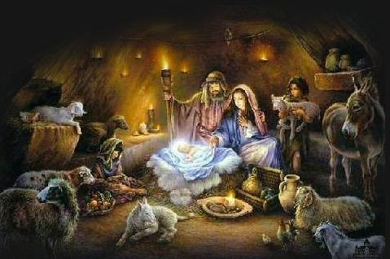

Slide 9
Luke 2:8 Now there were in the same country shepherds living out in the fields, keeping watch over their flock by night. ⁹ And behold, an angel of the Lord stood before them, and the glory of the Lord shone around them, and they were greatly afraid. ¹⁰ Then the angel said to them, "Do not be afraid, for behold, I bring you good tidings of great joy which will be to all people. ¹¹ "For there is born to you this day in the city of David a Savior, who is Christ the Lord. ¹² "And this will be the sign to you: You will find a Babe wrapped in swaddling cloths, lying in a manger." ¹³ And suddenly there was with the angel a multitude of the heavenly host praising God and saying: ¹⁴ "Glory to God in the highest, And on earth peace, goodwill toward men!"

Slide 10
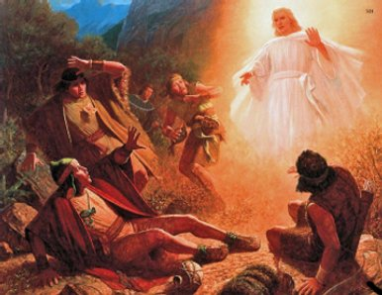

Slide 11
Luke 2:15 So it was, when the angels had gone away from them into heaven, that the shepherds said to one another, "Let us now go to Bethlehem and see this thing that has come to pass, which the Lord has made known to us." ¹⁶ And they came with haste and found Mary and Joseph, and the Babe lying in a manger. ¹⁷ Now when they had seen Him, they made widely known the saying which was told them concerning this Child. ¹⁸ And all those who heard it marveled at those things which were told them by the shepherds. ¹⁹ But Mary kept all these things and pondered them in her heart. ²⁰ Then the shepherds returned, glorifying and praising God for all the things that they had heard and seen, as it was told them.

Slide 12
Luke 2:21 And when eight days were completed for the circumcision of the Child, His name was called JESUS, the name given by the angel before He was conceived in the womb.

Slide 13
Luke 2:22 Now when the days of her purification according to the law of Moses were completed, they brought Him to Jerusalem to present Him to the Lord ²³ (as it is written in the law of the Lord, "Every male who opens the womb shall be called holy to the LORD"), ²⁴ and to offer a sacrifice according to what is said in the law of the Lord, "A pair of turtledoves or two young pigeons."

Slide 14
The days of purification were 40 days for a son and 80 days for a daughter (Lev. 12:1-5).

Slide 15
Once she was considered clean, a sacrifice was required (Lev. 12:6-8).

Slide 16
2 Corinthians 8:9 For you know the grace of our Lord Jesus Christ, that though He was rich, yet for your sakes He became poor, that you through His poverty might become rich.

Slide 17
Luke 2:25 And behold, there was a man in Jerusalem whose name was Simeon, and this man was just and devout, waiting for the Consolation of Israel, and the Holy Spirit was upon him. ²⁶ And it had been revealed to him by the Holy Spirit that he would not see death before he had seen the Lord's Christ. ²⁷ So he came by the Spirit into the temple. And when the parents brought in the Child Jesus, to do for Him according to the custom of the law, ²⁸ he took Him up in his arms and blessed God and said: ²⁹ "Lord, now You are letting Your servant depart in peace, According to Your word; ³⁰ For my eyes have seen Your salvation ³¹ Which You have prepared before the face of all peoples, ³² A light to bring revelation to the Gentiles, And the glory of Your people Israel."

Slide 18
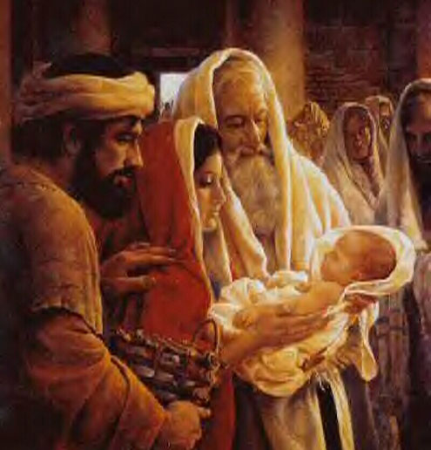

Slide 19
Luke 2:33 And Joseph and His mother marveled at those things which were spoken of Him.

Slide 20
Simeon was not telling Joseph and Mary anything they had not previously learned about Jesus. They marvelled, rather, that these truths should come to them from a stranger and under such circumstances. The marvel to them, and to us, is that everything that was said by all of God's messengers harmonized so perfectly. Charles L. Childers, op. cit., p. 453.

Slide 21
Luke 2:34 Then Simeon blessed them, and said to Mary His mother, "Behold, this Child is destined for the fall and rising of many in Israel, and for a sign which will be spoken against ³⁵ "(yes, a sword will pierce through your own soul also), that the thoughts of many hearts may be revealed."

Slide 22
Luke 2:36 Now there was one, Anna, a prophetess, the daughter of Phanuel, of the tribe of Asher. She was of a great age, and had lived with a husband seven years from her virginity; ³⁷ and this woman was a widow of about eighty-four years, who did not depart from the temple, but served God with fastings and prayers night and day. ³⁸ And coming in that instant she gave thanks to the Lord, and spoke of Him to all those who looked for redemption in Jerusalem.

Slide 23
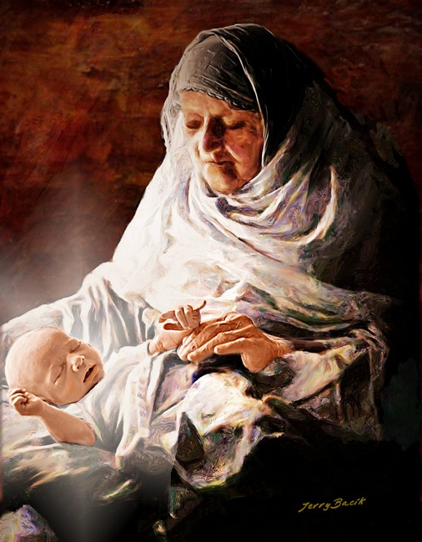

Slide 24
Luke 2:39 So when they had performed all things according to the law of the Lord, they returned to Galilee, to their own city, Nazareth. ⁴⁰ And the Child grew and became strong in spirit, filled with wisdom; and the grace of God was upon Him.

Slide 25
According to Boles, there were 7 stages to the development of a Jewish child that Jesus would have gone through. He says:
The newborn babe (Isa. 9:6)
The suckling (Isa. 11:8)
The suckling beginning to ask for food (Lam. 4:4)
The weaned child (Isa. 28:9)
The child clinging to its mother (Jer. 40:7)
The child becoming firm and strong (Isa. 7:14)
The child becoming free and independent (Isa. 31:8)

